Slide 1
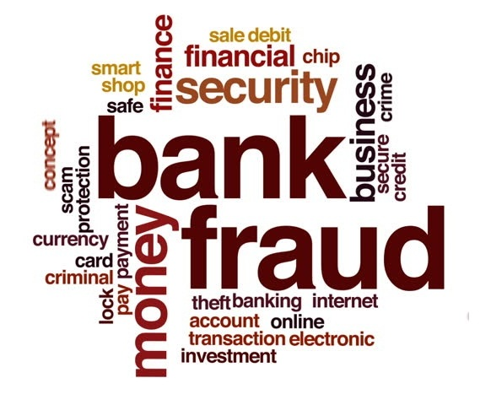
Online payment/Credit Card Fraud Detection
Deepika Jindal

Slide 2
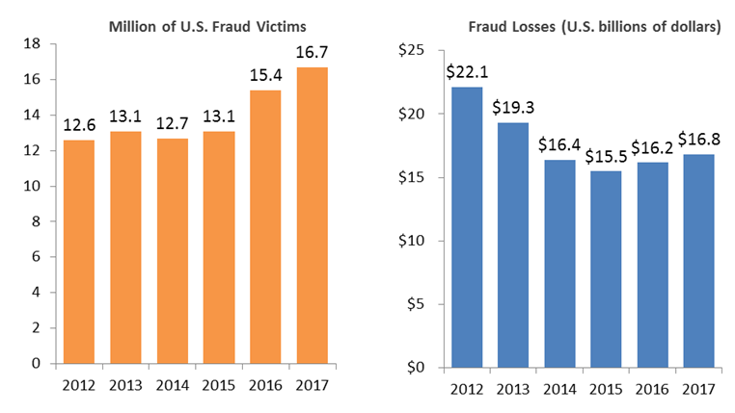
Fraud Victims and Losses Continue Three-Year Rise

Slide 3
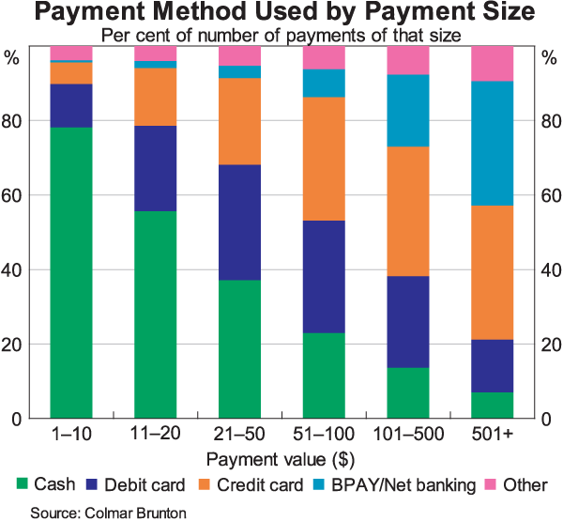

Why is it urgent to work on this now?
Digitalization in the financial sector has made it more vulnerable towards frauds
Increase in dependence of mobile and online transactions
Amount of Literature

Slide 4
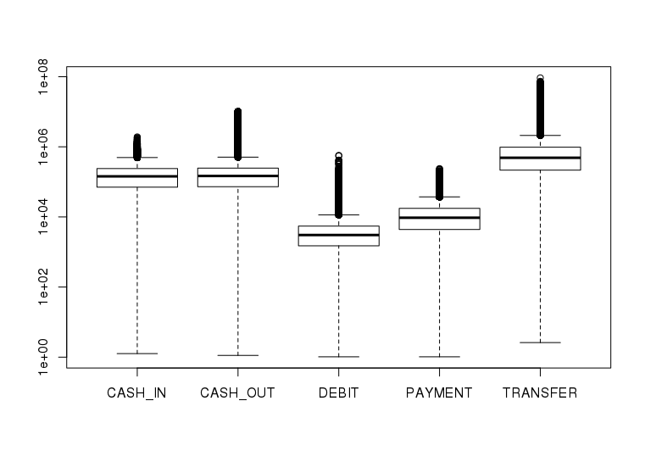
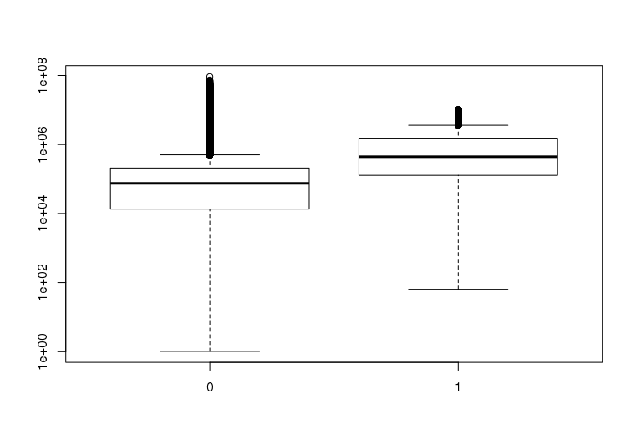

Exploring the Data Variables
Types of transactions:
Distribution of average amount of fraud and non-fraud transactions:
Observations:
On average transfer, online transfers are higher value transactions
The order of fraud transactions is higher than the order of non-fraud transactions

Slide 5
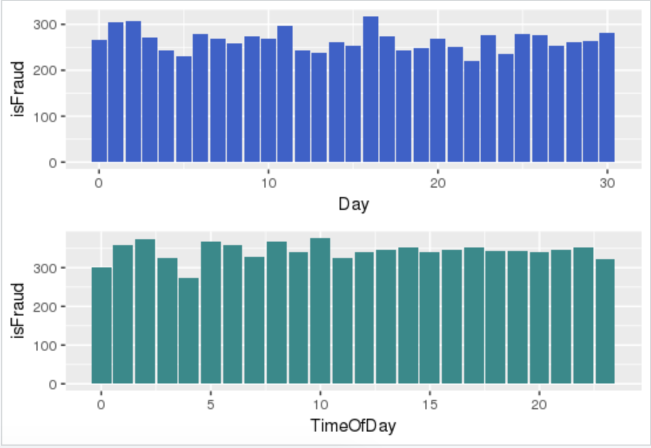
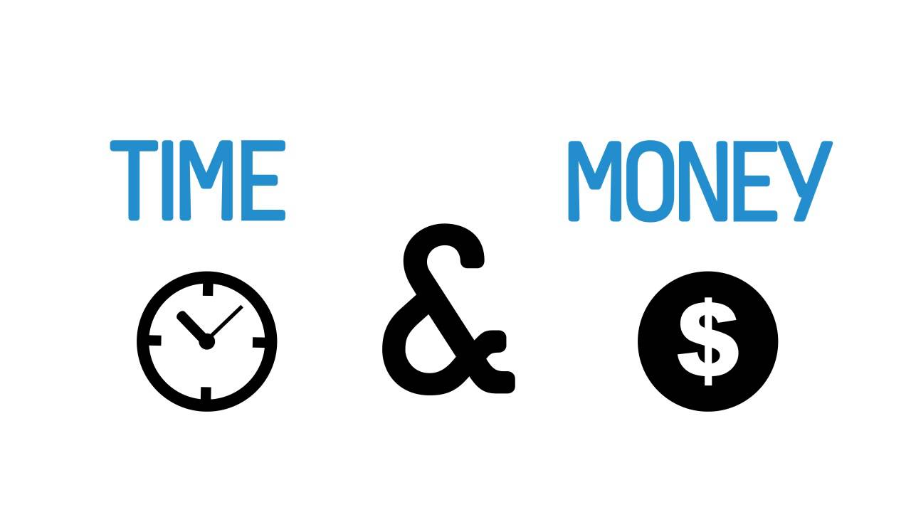
Variation of Financial Fraud with Time
Observations:
Number of frauds are constant throughout the day and time range.
Normal transactions are more during the day, hence, the average fraud transactions are high at the closing times of banks and during out of office hours
The graphs above show the trend of frauds averaged over:
A Day
24 Hours in a Day

Slide 6
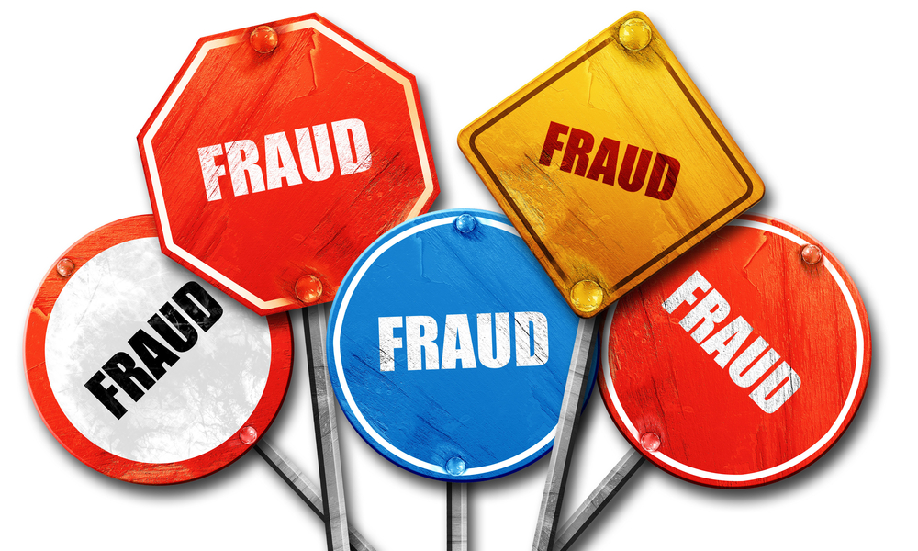
Some Statistics of Fraudulent Transactions
1.2 out of a thousand transactions are fraudulent
.2% of total transaction amount is Fraud
Only 2 types of transactions, i.e., online transfers and cash outs are frauds

Slide 7

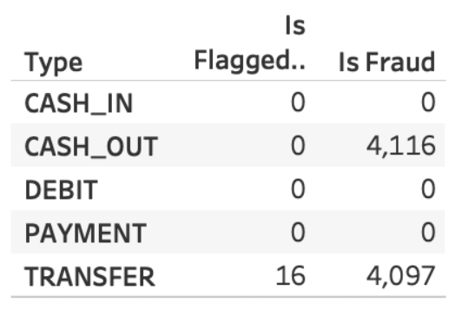
The Current Scenario:
The two affected areas of fraud are:
Cash-Out
Transfer
Transfer refers to Electronic (Mobile and Card) Payments.
Only 16 out of 4097 fraudulent transactions were correctly identified.

Slide 8
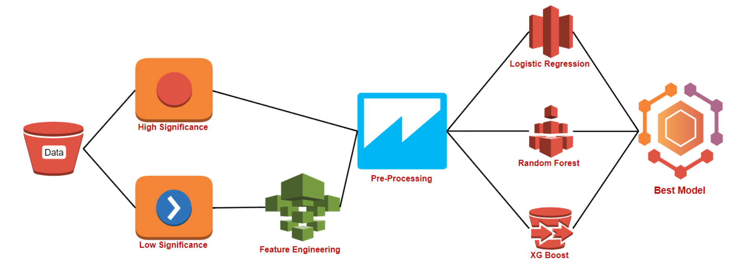
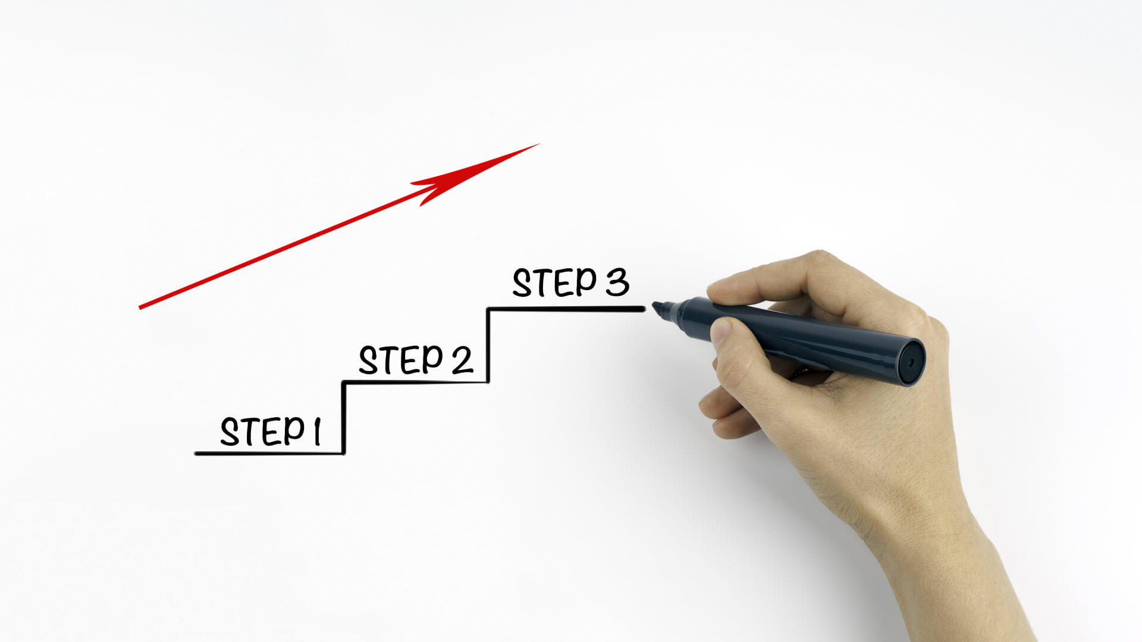
Steps in the process:

Slide 9
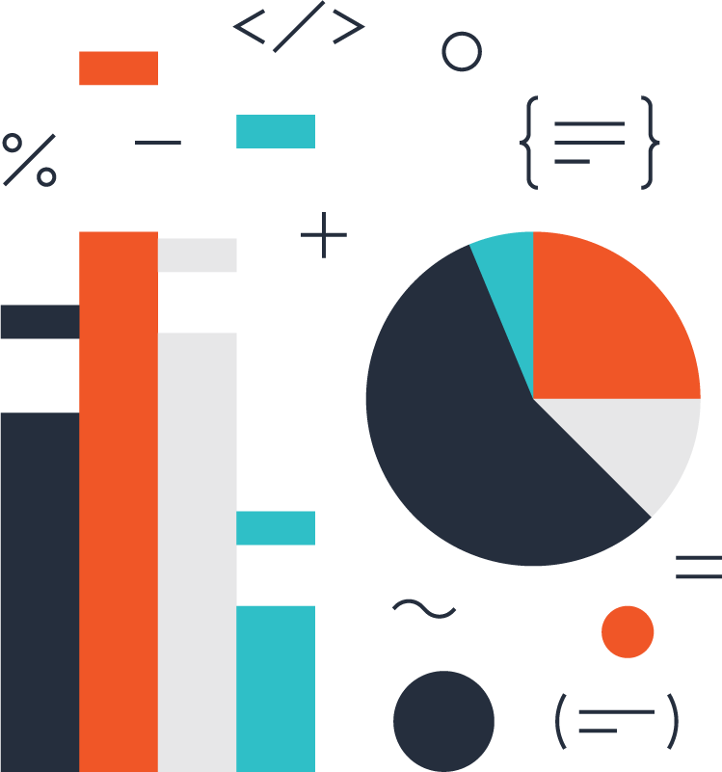
Modeling:
To predict whether a transaction is a Fraud or not is a Classification problem:
Results:
Is fraud
Is not Fraud
We use the following types of sampling
to balance the data:
Unbalanced Data:
Up-Sampling
Down-Sampling
Models used:
Random Forest
XGBOOST
Logistic Regression

Slide 10
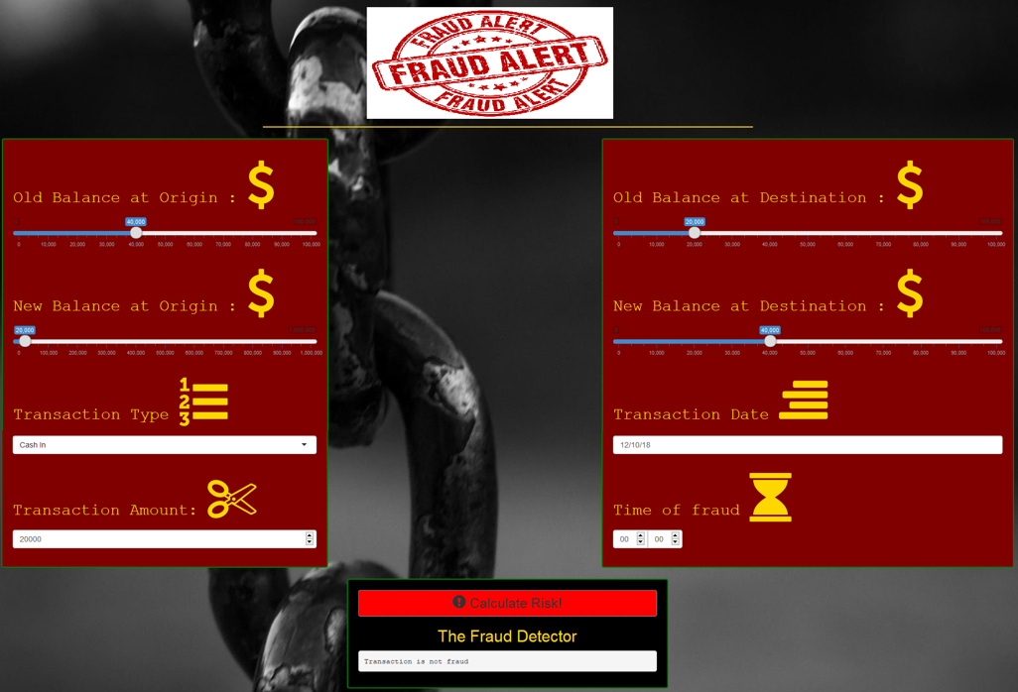
User Interfacing:

Slide 11
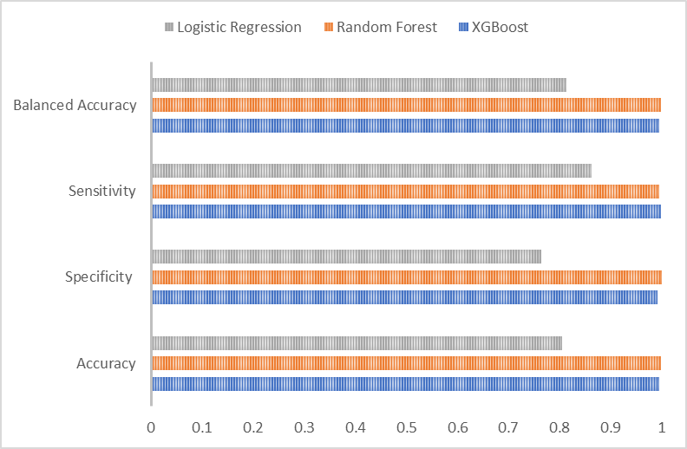
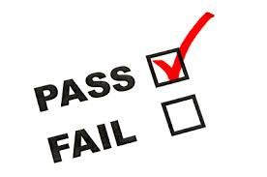
Results:

Slide 12

Driving Parameters
Significant Parameters
Parameter | P-Value
Day | 2e-16
Time Of Day | 2e-16
Amount | 2e-16
XAST | 2e-16

Slide 13

Our suggestions to curb the fraud
Deploying detection model and predicted probabilities to prevent fraud
1
Enforcing 2 step verification for suspected transactions
2
Blocking the transaction and the payment method where probability of being a fraud is high(higher than 0.6)
3

Slide 14

Way Forward:
Plans:
To include more parameters in banking to make the model more robust.
To prepare the model to tackle new types of frauds using Reinforced learning.
To track real-time bank transactions using the Fraud Alert app.
Program the model to look more closely on large transactions

Slide 15

Questions?

Slide 16

Thank You

